Slide 1


Accounting-Shopping Application
an internal business application to manage invoices, payments, and costs for a small pastry business that sells its products to other businesses.

Slide 2
Objective
User Authentication:
Implement a secure user authentication system to control access to the application. Different roles (e.g., admin, staff) may have different levels of access.
Dashboard:
Create a dashboard for users to get an overview of key metrics, such as total sales, pending invoices, and recent transactions.
Invoice Management:
Implement features for creating, editing, and managing invoices. Include information such as customer details, product details, quantities, and prices. With features like invoice status (pending, paid) and due dates.
Payment Tracking:
Allow users to record and track payments against invoices. With features to mark invoices as paid, view payment history, and generate payment receipts.
Expense Tracking:
Functionality for tracking business expenses. This can include costs associated with production, packaging, transportation, and any other operational expenses.
Product Management:
Create a product management system to keep track of pastry products. Include details such as product name, description, unit price, and inventory levels.
Reporting:
Reporting features to generate financial reports, sales reports, and expense reports. To help in analyzing the performance of the business.
Search and Filters:
Search and filter options to make it easy for users to find specific invoices, payments, or expenses.
Notification System:
Implementing a notification system to alert users about upcoming invoice due dates, outstanding payments, or other important events.
Backup and Recovery:
Implementing a robust backup and recovery system to ensure that important data is not lost. Regularly backup the database and implement procedures for data recovery.

Slide 3
Tools
JSP –Java Server Pages
Bootstrap/ HTML CSS
MySQL
Tomcat
IDE

Slide 4
UML Diagram
Shop
- shopId: int
- shopName: String
- location: String
+ generateInvoice(customer: Customer, products: List<Product>): Invoice
Invoice
- invoiceId: int
- customer: Customer
- products: List<Product>
- totalAmount: double
- transaction: Transaction
+ processInvoice(): Transaction
Product
- productId: int
- productName: String
- price: double
- productImage: String
- productLevel: double
+ IncLevel(level: double): void
+ DecLevel(level: double): void
Payment
- paymentId: int
- paymentDate: Date
- description: String
- customer: Customer
- amount: double
- transaction: Transaction
+ processPayment(): Transaction
Customer
- customerId: int
- customerName: String
- customerLocation: String
- customerNumber: String
- customerImage: String

Slide 5
UML Diagram
Expense
- expenseId: int
- expenseDate: Date
- description: String
- amount: double
- transaction: Transaction
+ processExpense(): Transaction
Transaction
- transactionId: int
- transactionDate: Date
- totalAmount: double
- transactionMethod: TransactionMethod
- type: TransactionType
- description: String
- customer: Customer
TransactionMethod
DEBIT: int
CREDIT: int
TransactionType
INVOICE: int
PAYMENT: int
EXPENSE: int

Slide 6
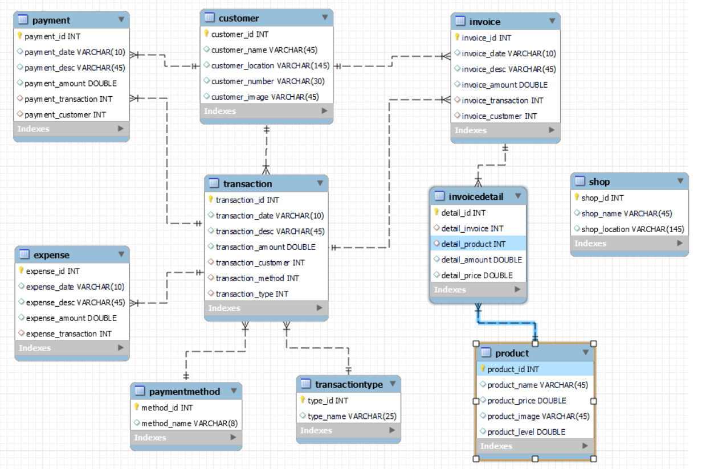
Database Diagram

Slide 7
Flow of the Application
Log in
Product
Customer
Invoice
Payment
Expense
Transactions

Slide 8


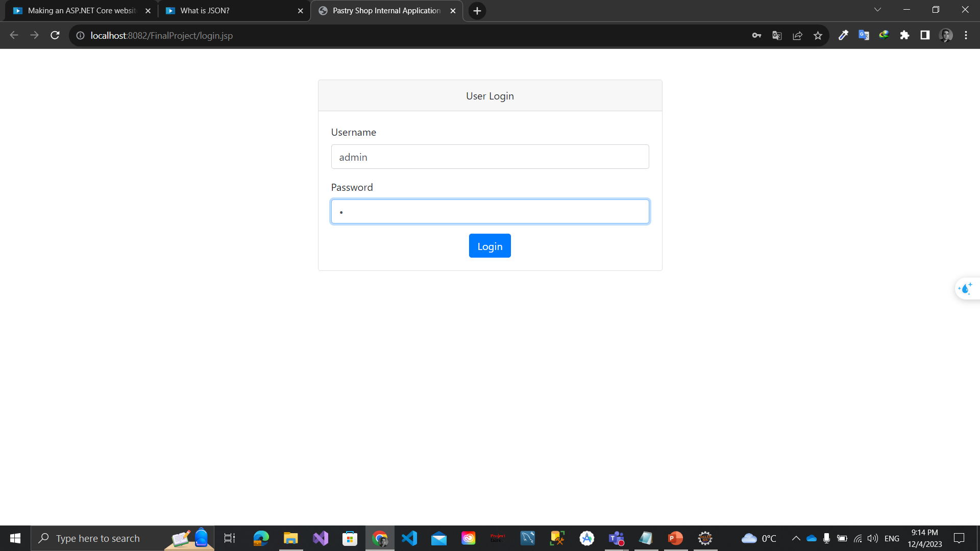
Log in Page
Username / Password
Check Validate
Retrieve user Role

Slide 9
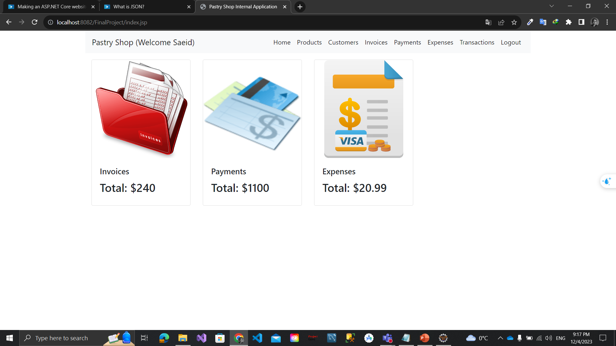
Home Page
Dashboard
Navbar
User info

Slide 10
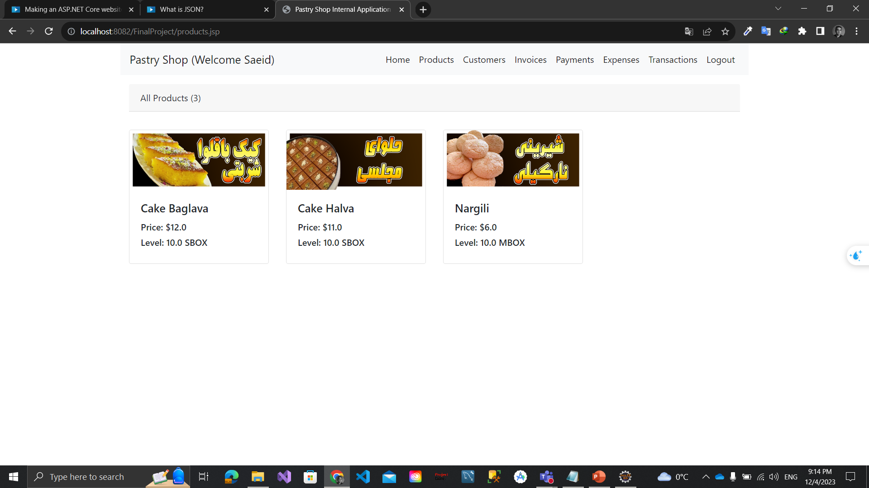
Product Page
Adding new Product
Edit Product
Increase Product Level
Product Reports

Slide 11
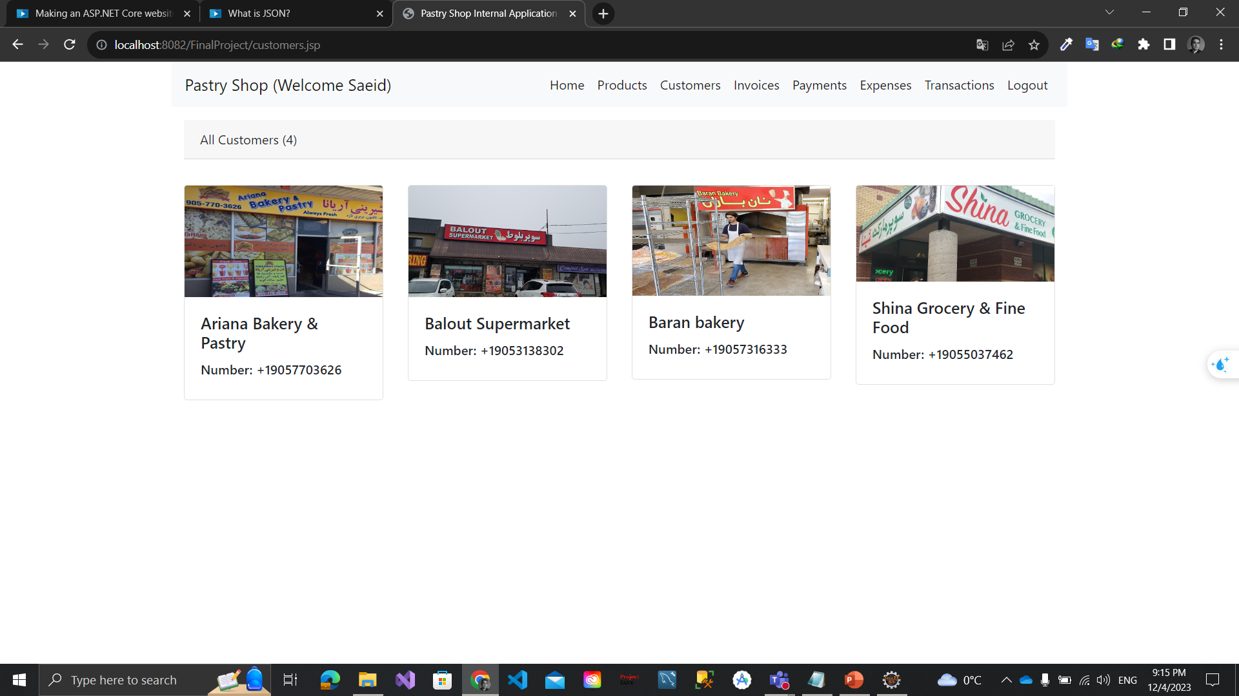
Customer Page
Adding new Customer
Edit Customer
Customer Reports

Slide 12
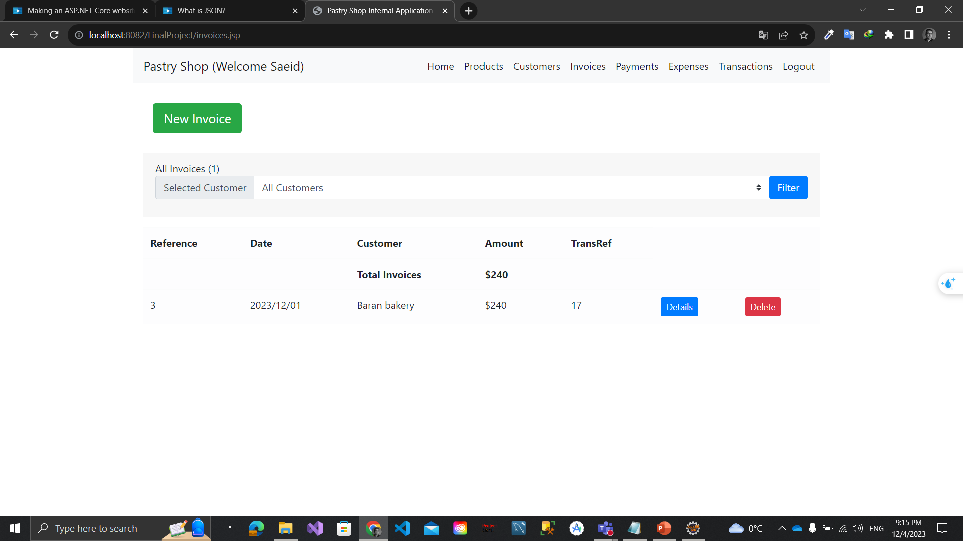
Invoice Page
New Invoice for a Customer
Edit Invoice
Invoice Reports

Slide 13
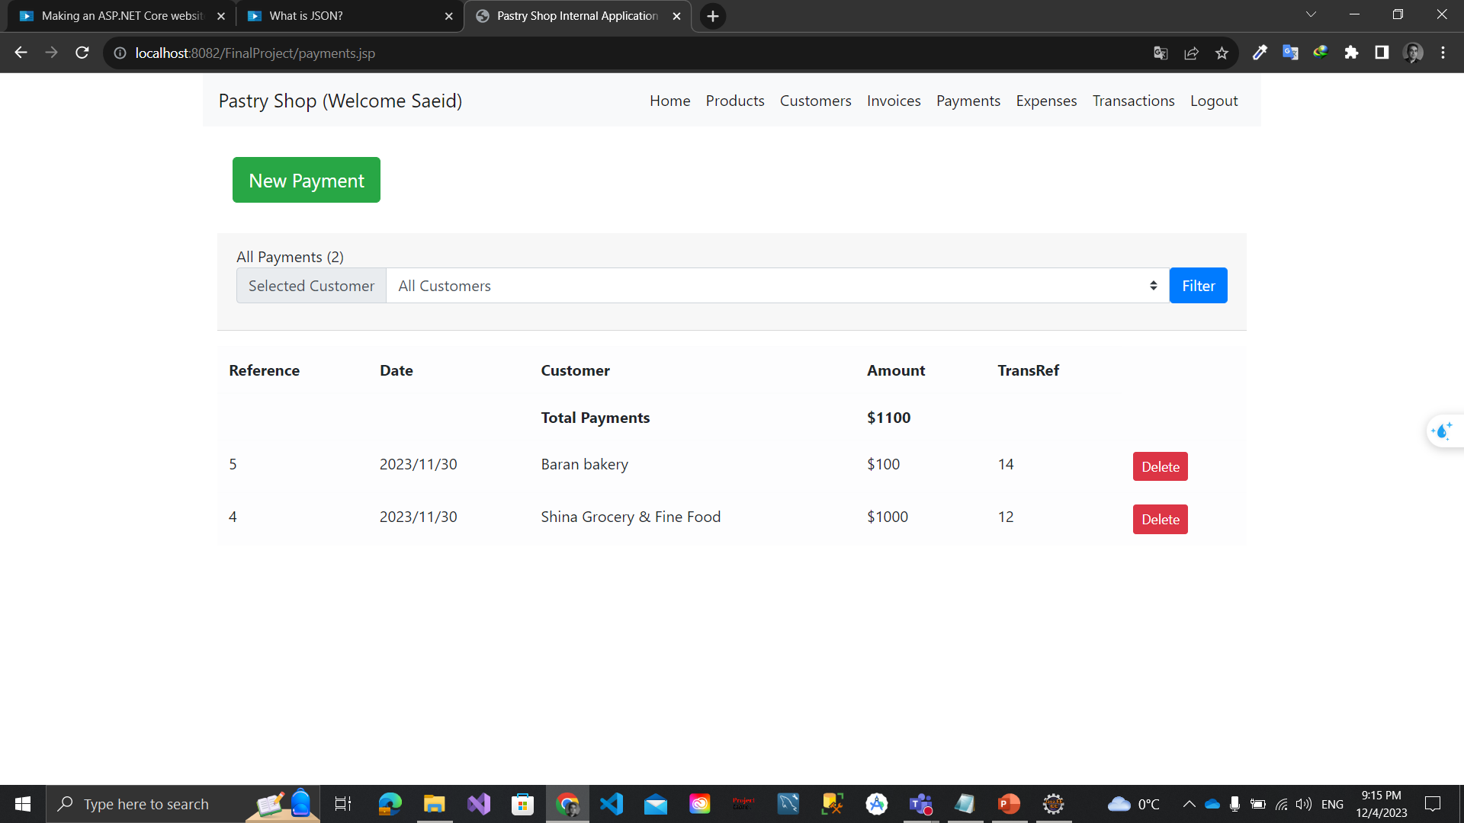
Payment Page
New Payment from a Customer
Edit Payment
Payment Reports

Slide 14
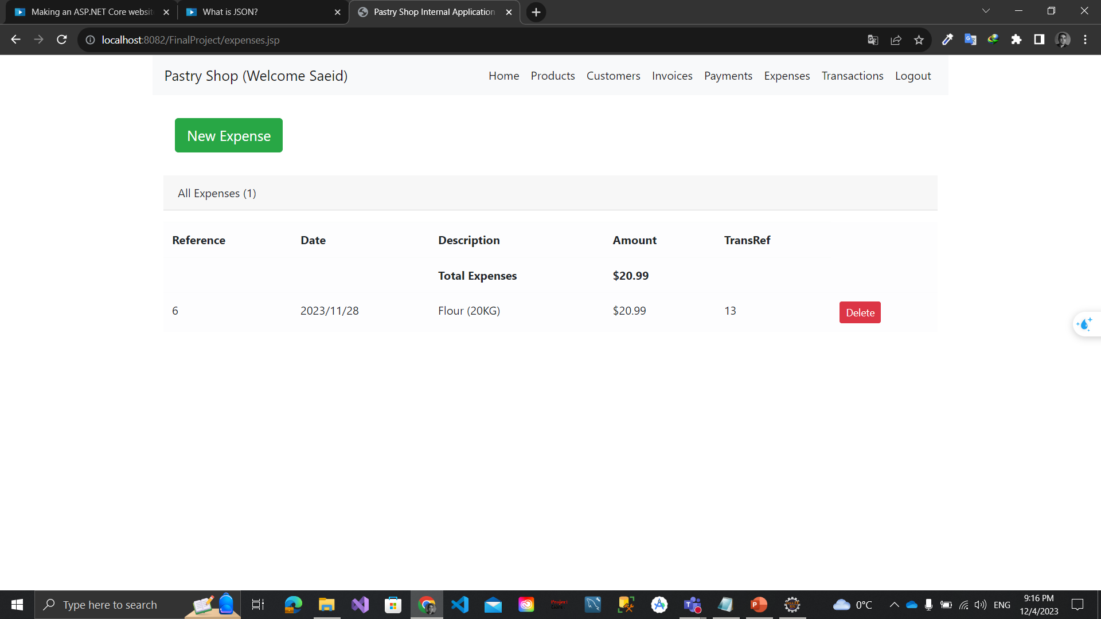
Expense Page
New Expense
Edit Expense
Expense Reports

Slide 15
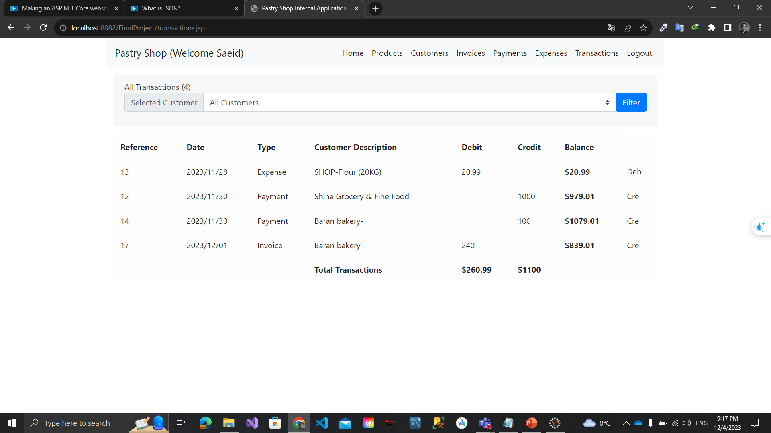
Transaction Page
Transaction Report

